Slide 1

MICRON – HF WASTEWATER TREAMENT
SIMULATION & BENCH TESTING – Dec 2021
Siva Kumar Kota/Chun Yew
Hiep Le/Sankar
Part 2

Slide 2
Option 5 -NF270 followed by SWRO (clarified water recycle)
F: 150 m3/hr
F:1136 mg/l
PO4: 100 mg/l
NF 270
SWRO
Polishing Filters
Treated Water
UF
HF WW
Coagulation, Clarifier
Coagulation, Clarifier
CaF2 sludge
Phosphate sludge
2
Notes:
NF/RO –projections
FBR –Reject treatment
Npv calculations

Slide 3
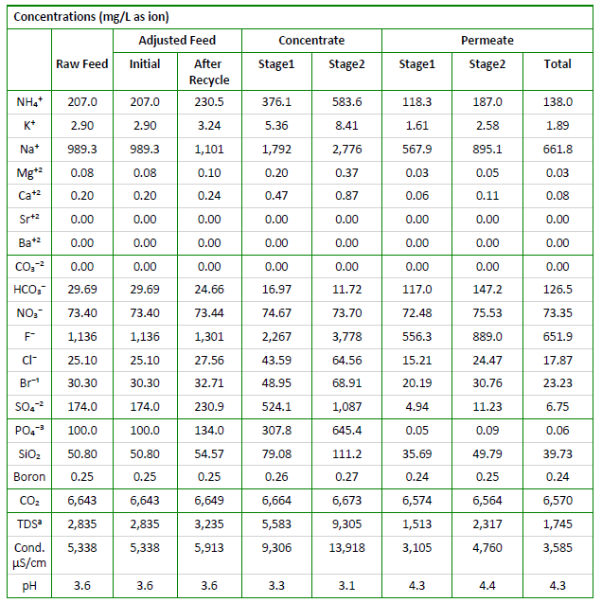
Option 5– NF270 followed by SWRO
NF270

Slide 4
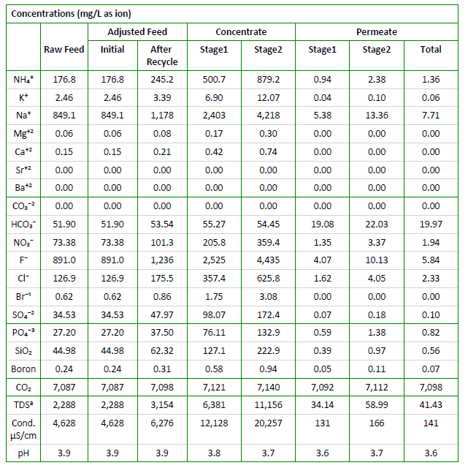
Option 5– SWRO (NF permeate and F rich clarified water)
SWRO

Slide 5
^{Option 5a -} NF270 followed by SWRO (separate sludge)
F: 150 m3/hr
F:1136 mg/l
PO4: 100 mg/l
NF270
SWRO
Polishing Filters
Treated Water
UF
HF WW
Coagulation, Clarifier
Coagulation, Clarifier
CaF2 sludge
Phosphate sludge
5
Notes:
NF/RO –projections
FBR –Reject treatment
Npv calculations
Ammonia -20 ppm
TOC-<5
FLUORIDE -800 PPM

Slide 6
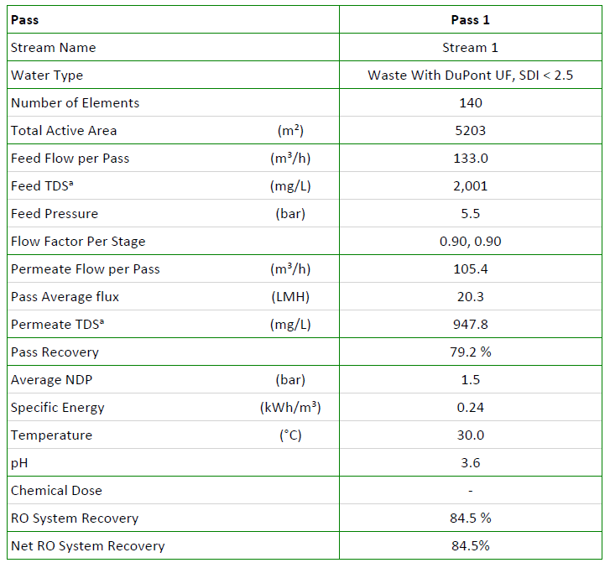
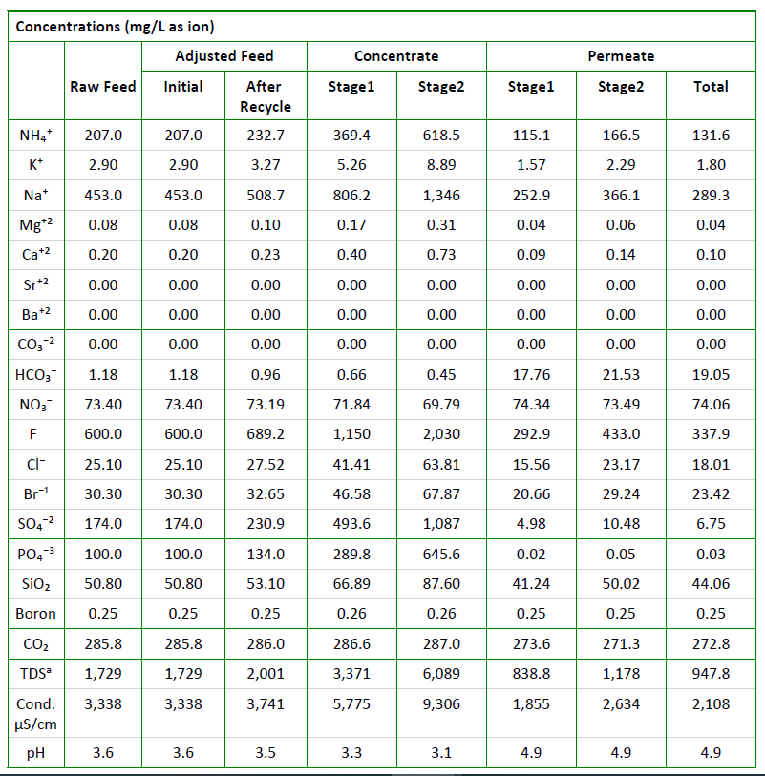
Option 5a – NF270 (Loose membrane)

Slide 7
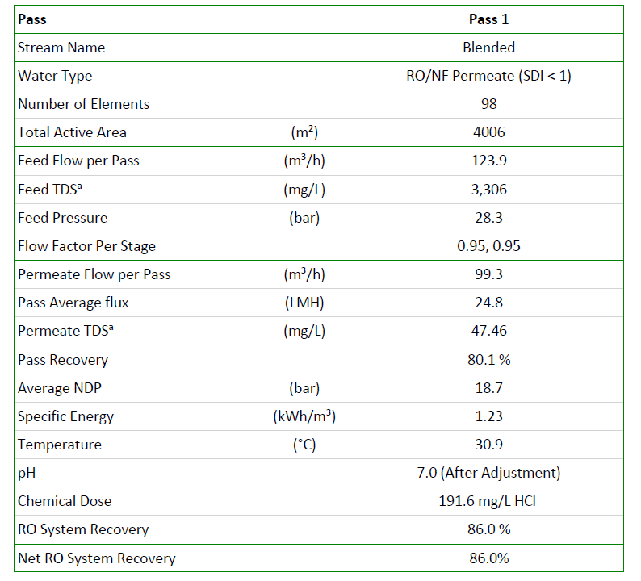
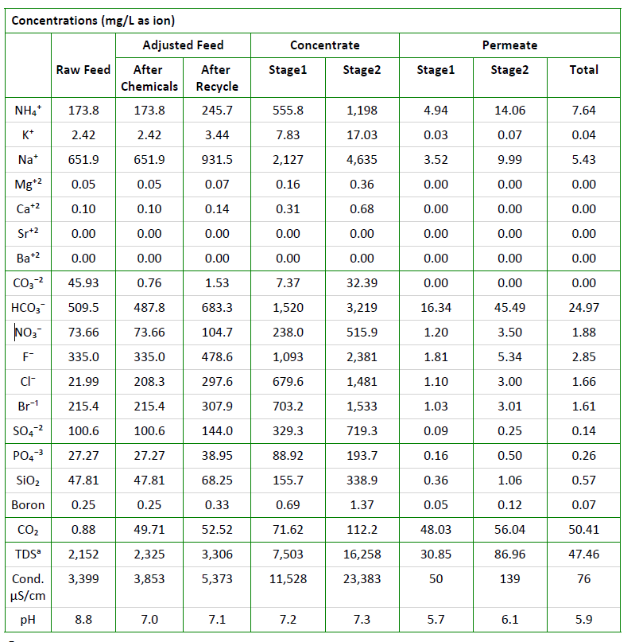
Option 5a – SWRO with pH adjustment

Slide 8
NEWater spec
Chemical Parameters
Ammonia (as N) | mg/L | <1.0
Aluminium | mg/L | <0.1
Barium | mg/L | <0.1
Boron | mg/L | <0.5
Calcium | mg/L | <20
Chloride | mg/L | <20
Copper | mg/L | <0.05
Fluoride | mg/L | <0.5
Iron | mg/L | <0.04
Manganese | mg/L | <0.05
Nitrate (as N) | mg/L | <5
Sodium | mg/L | <20
Sulphate | mg/L | <5
^{Silica (as SiO}₂⁾ | mg/L | <3
Strontium | mg/L | <0.1
Total Trihalomethanes Ratio | - | <0.04
Total Organic Carbon (TOC) | mg/L | <0.5
^{Total Hardness (as CaCO}₃⁾ | mg/L | <50
Zinc | mg/L | <0.1

Slide 9
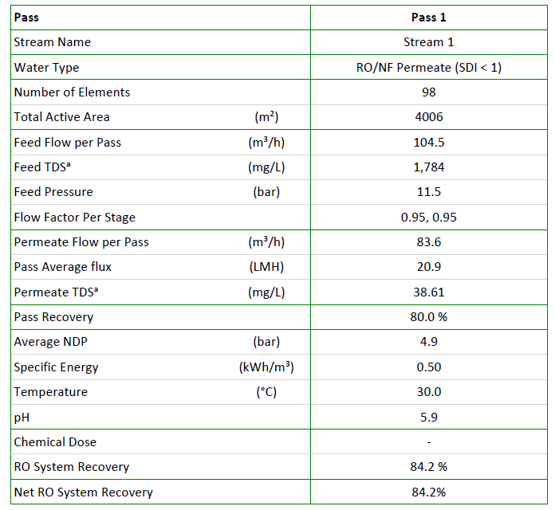
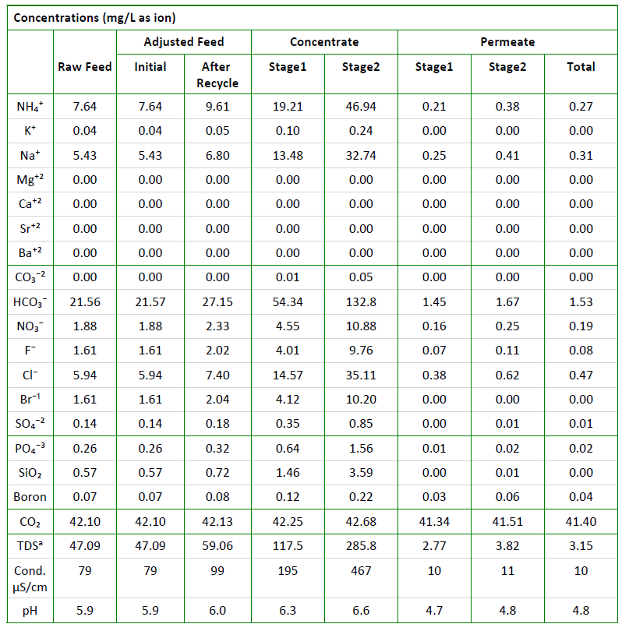
Option 5a – polishing BWRO to meet NEWater
Notes:
Cooling water spec
Ammonia<5ppm
Fluoride<2 ppm

Slide 10
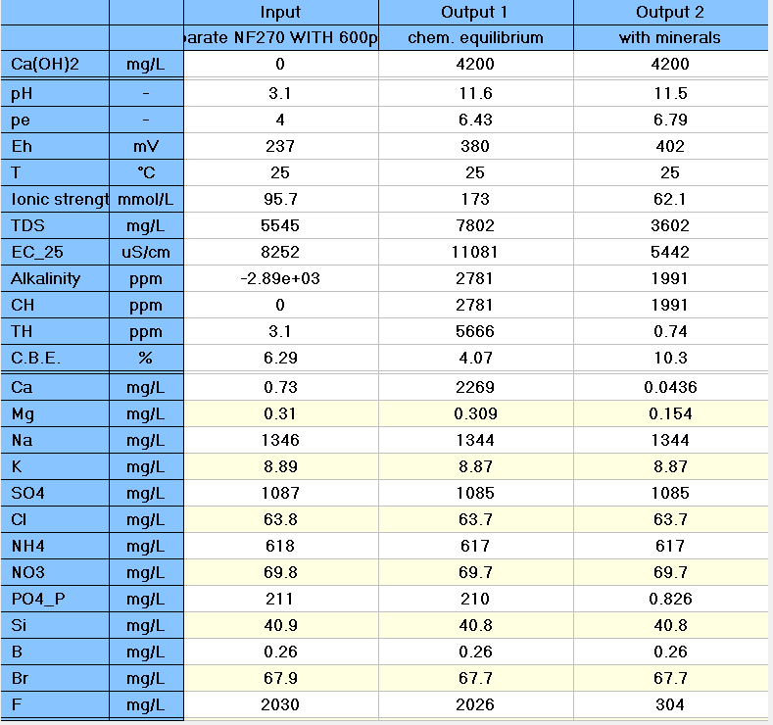
Option 5a - NF270 Reject chemical precipitation using Ca(OH)2

Slide 11
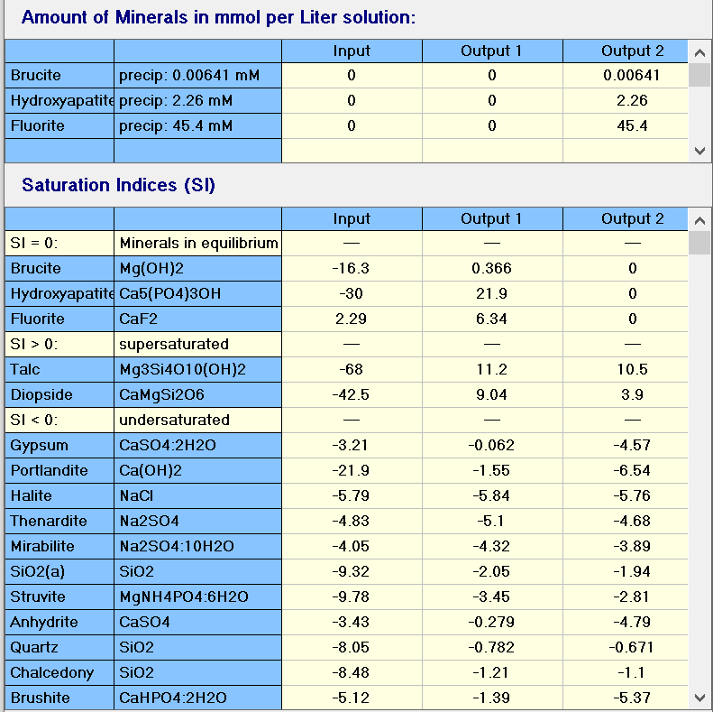
Option 5a- NF270 Reject chemical precipitation using Ca(OH)2

Slide 12
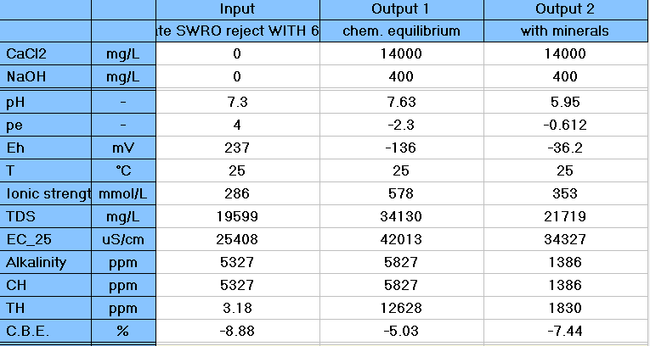
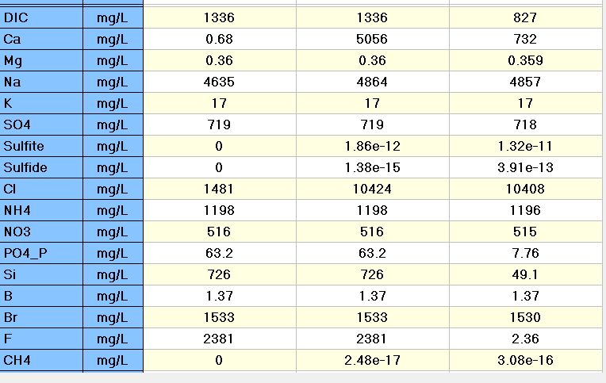
Option 5a-SWRO Reject chemical precipitation

Slide 13
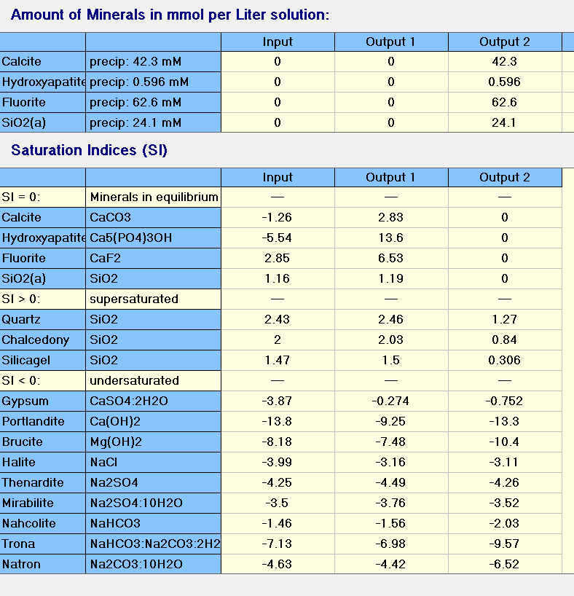
Option 5a -SWRO Reject chemical precipitation

Slide 14
^{Option 6 -} NF270 followed by SWRO (F-800 ppm)
F: 150 m3/hr
F:800 mg/l
PO4: 100 mg/l
UF
NF270
Stream 8
SWRO
BWRO (optional)
HF WW
Stream 2
Stream 3
Stream 7
Stream 1
Stream 4
Stream 9
CoagulationClarifier
Coagulation,Clarifier
Sludge
Sludge
Stream 11
Stream 6
Stream 10
Stream 5
Polishing filters
Stream 12
14
Notes:
NF/RO –projections
FBR –Reject treatment
Npv calculations
Ammonia -20 ppm
TOC-<5
FLUORIDE -800 PPM
AMMONIUM PEROXIDE WASTE- H2O2
PETERG7@

Slide 15
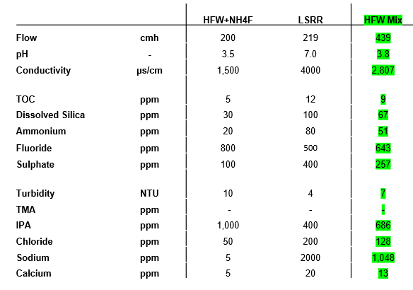
HFW – Feed Water Characteristics

Slide 16
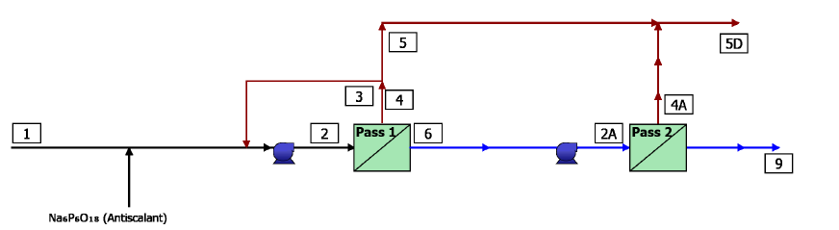
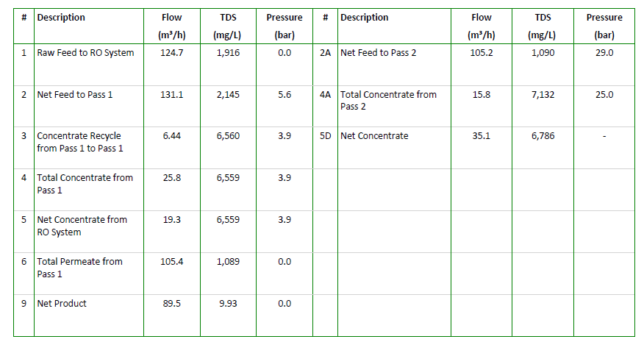
Option 6 – NF270 + SWRO With 800 ppm of F

Slide 17
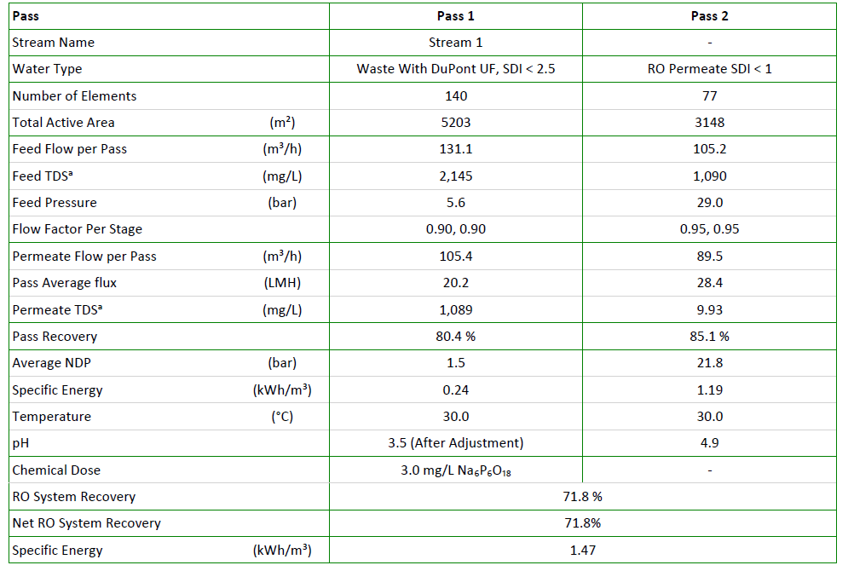
Option 6 – NF270 + SWRO With 800 ppm of F

Slide 18
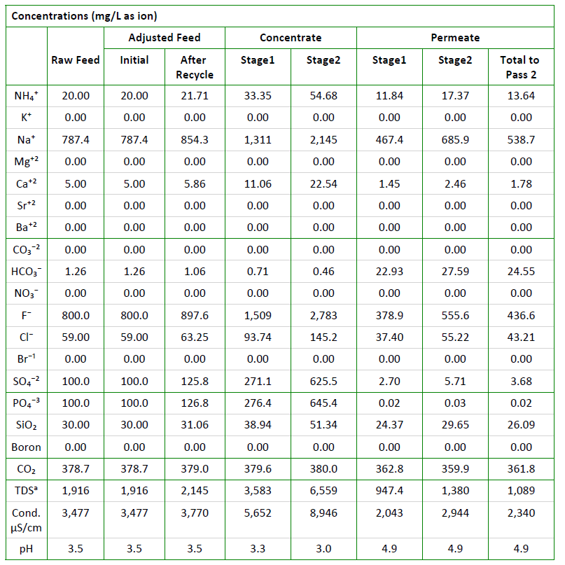
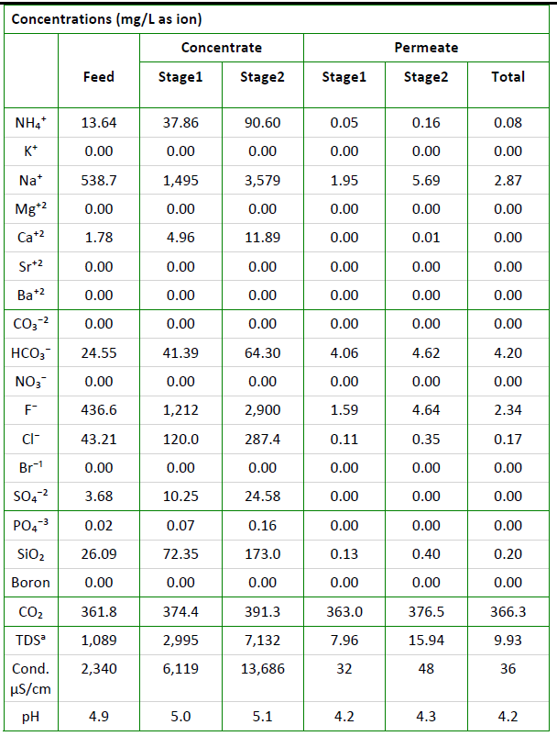
Option 6 – NF270+SWRO with 800 PPM of F
NF270
SWRO
Stream 4
Stream 9

Slide 19
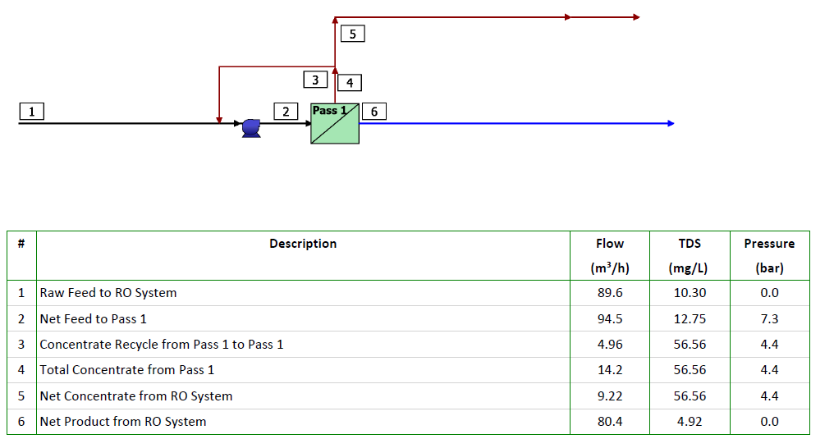
Option 6 – Polishing BWRO to meet NEWater
Notes:
Cooling water spec
Ammonia<5ppm
Fluoride<2 ppm

Slide 20
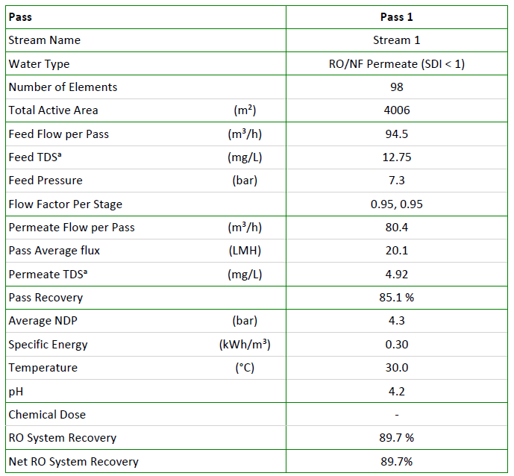
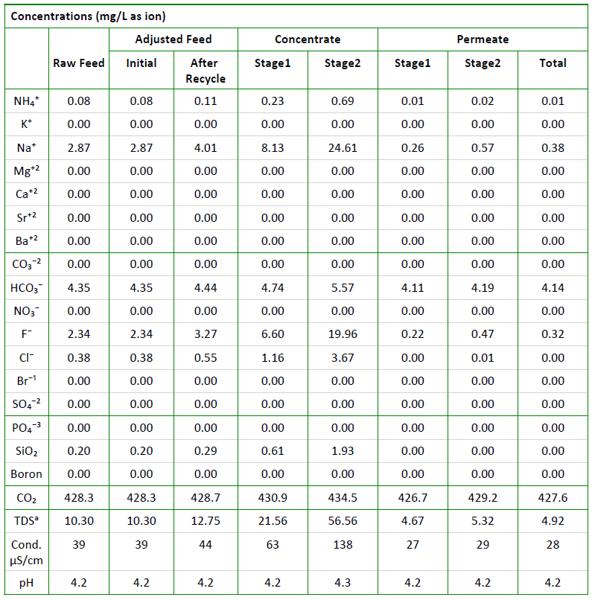
Option 6 – Polishing BWRO to meet NEWater
Notes:
Cooling water spec
Ammonia<5ppm
Fluoride<2 ppm

Slide 21
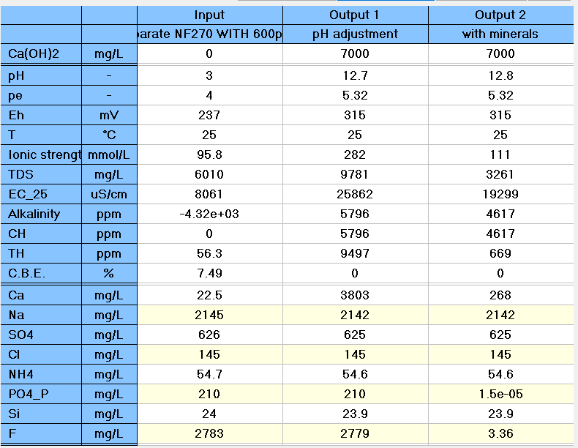
Option 6-NF270 Reject chemical precipitation using Ca(OH)2
Stream 4→19.3 m3/hr
Stream 6-sludge
Stream 5→18 m3/hr

Slide 22
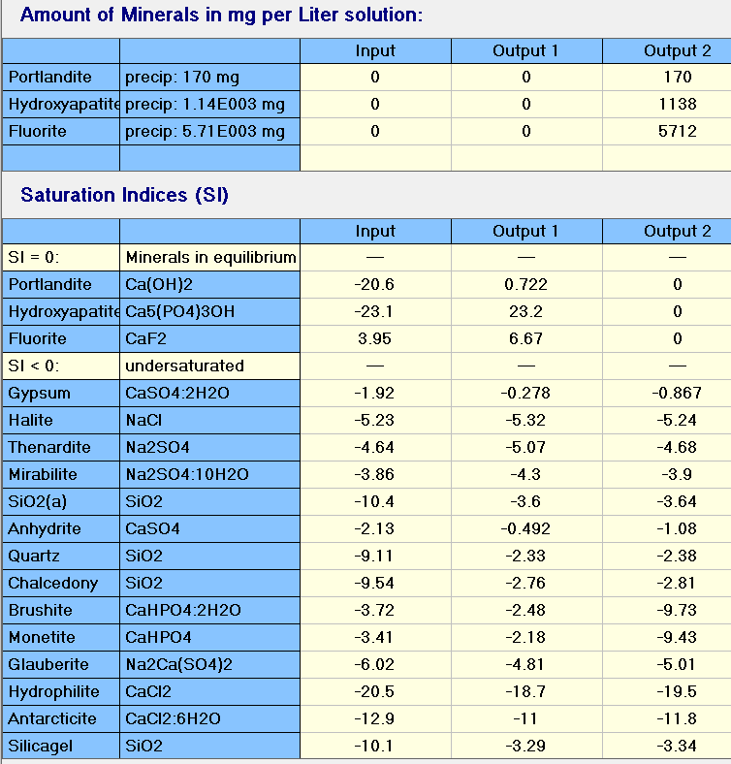
Option 6- NF270 Reject chemical precipitation using Ca(OH)2
>80% of CaF2 sludge

Slide 23

Option 6- SWRO Reject chemical precipitation
Stream 11-sludge
Stream 10→14.8 m3/hr
Stream 9→15.8 m3/hr

Slide 24
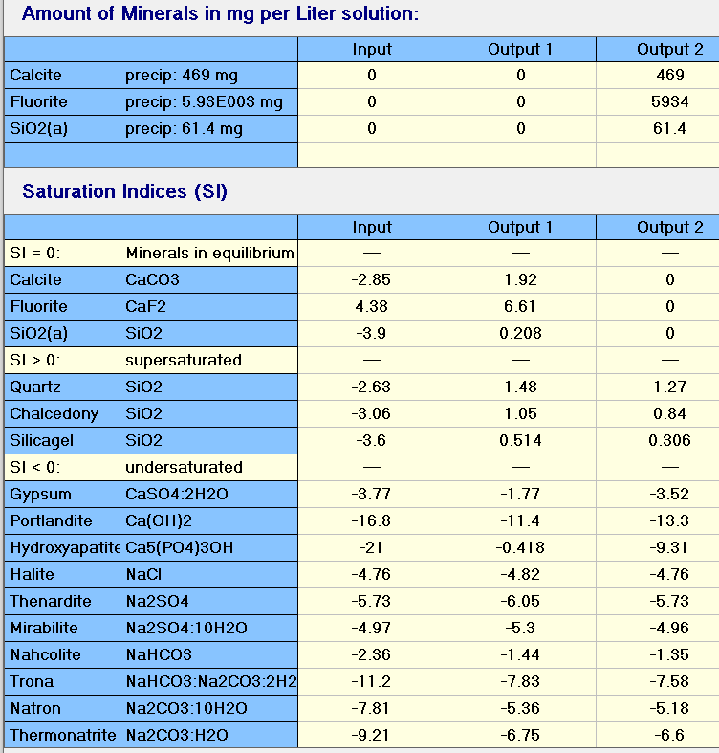
Option 6 -SWRO Reject chemical precipitation
>80% of CaF2 sludge

Slide 25
Option 6a – NF270 followed by SWRO (F-800 ppm and combined sludge)
F: 150 m3/hr
F:800 mg/l
PO4: 100 mg/l
UF
NF270
SWRO
BWRO (optional)
HF WW
Stream 2
Stream 3
Stream 9
Stream 1
Stream 10
Stream 4
Stream 5
CoagulationClarifier
Sludge
Stream 7
Stream 6
Polishing filters
Stream 8
25
Notes:
NF/RO –projections
FBR –Reject treatment
Npv calculations
Ammonia -20 ppm
TOC-<5
FLUORIDE -800 PPM

Slide 26

Option 6a–combined reject chemical precipitation –CaF2 sludge
Stream 7-sludge
Stream 6→33.5 m3/hr
Stream 4&5→35.3 m3/hr

Slide 27
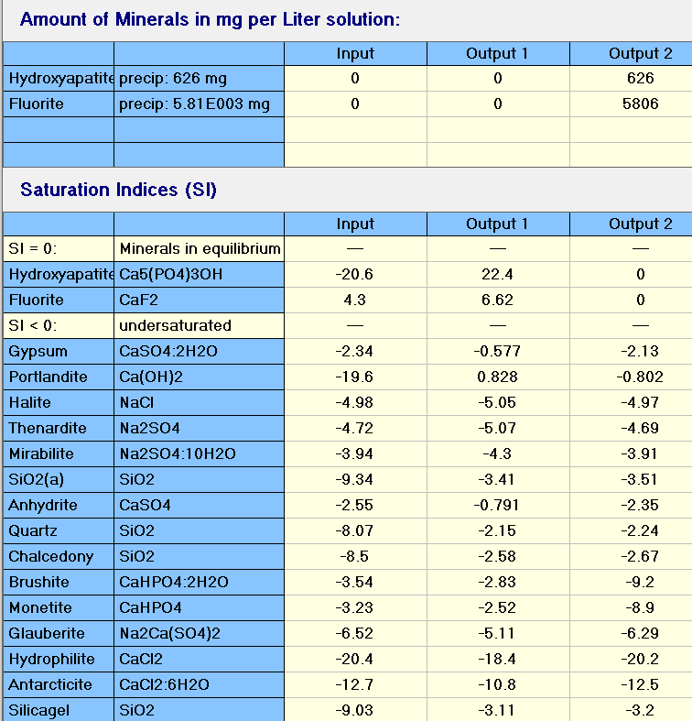
Option 6a–combined reject chemical precipitation –CaF2 sludge
>80% of CaF2 sludge

Slide 28
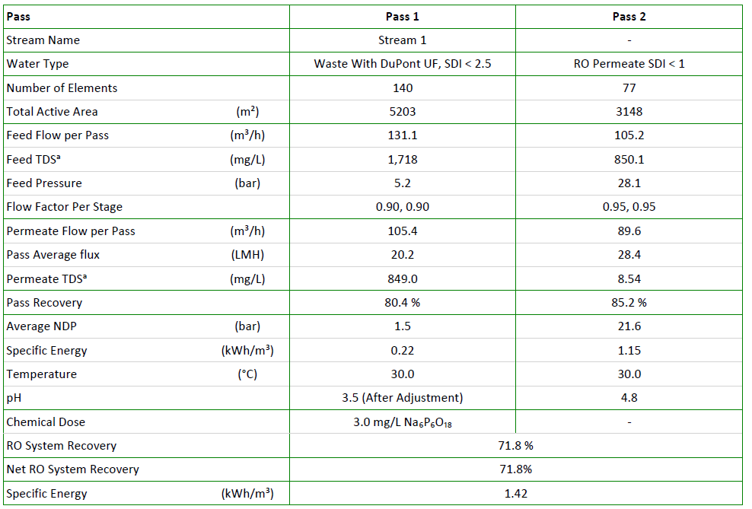
Option 6b – NF270 + SWRO With 600 ppm of F

Slide 29
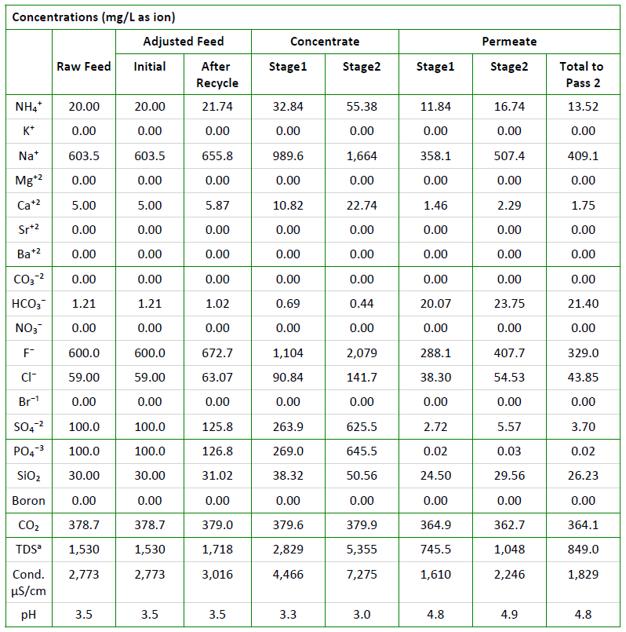
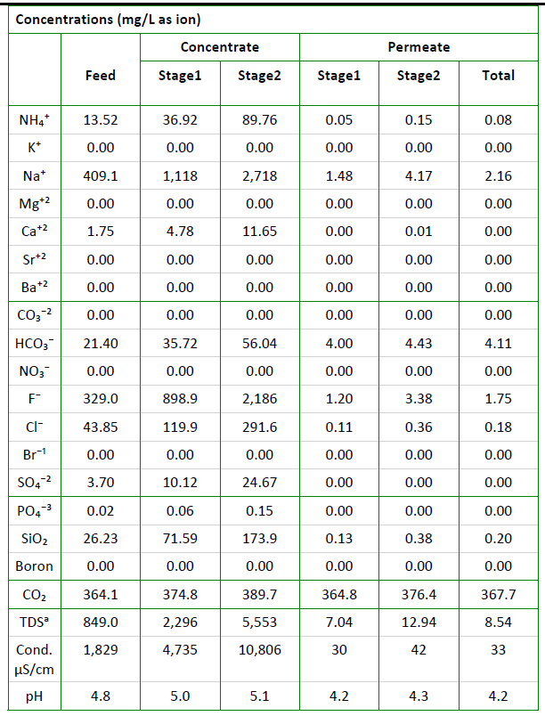
Option 6b – NF270+SWRO WITH 600 PPM of F
NF270
SWRO

Slide 30
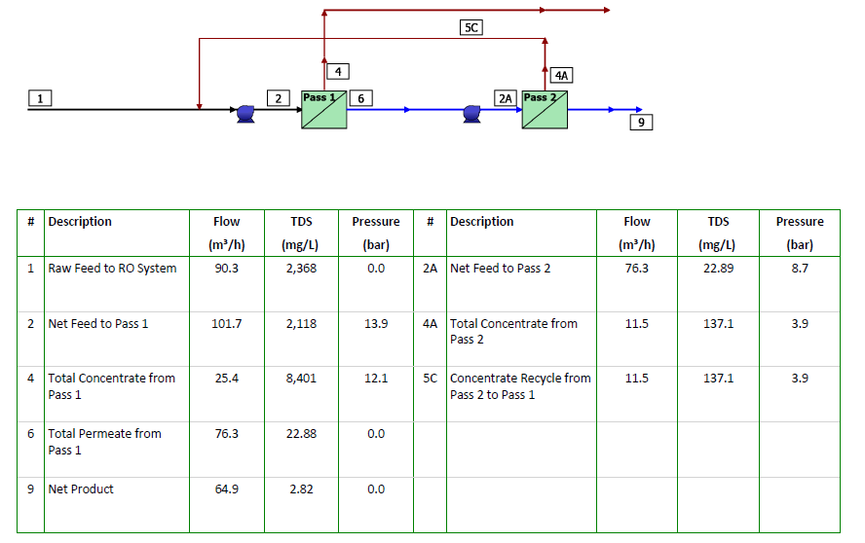
Option 7-HFW Effluent treatment – UF, RO

Slide 31
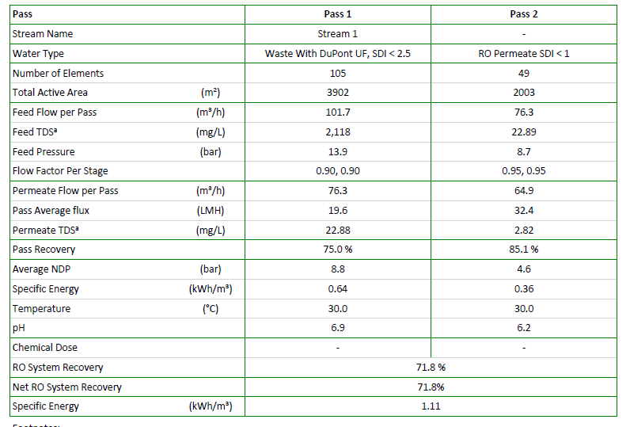
Option 7- HFW Effluent treatment ( UF & RO)

Slide 32
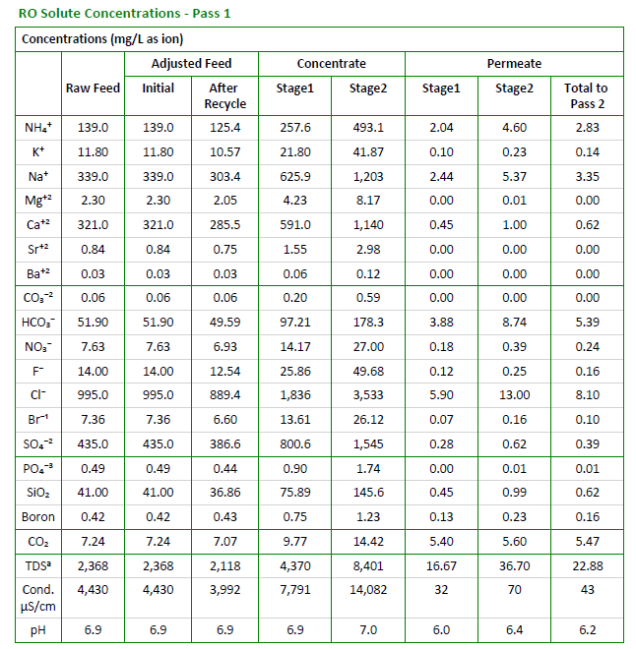
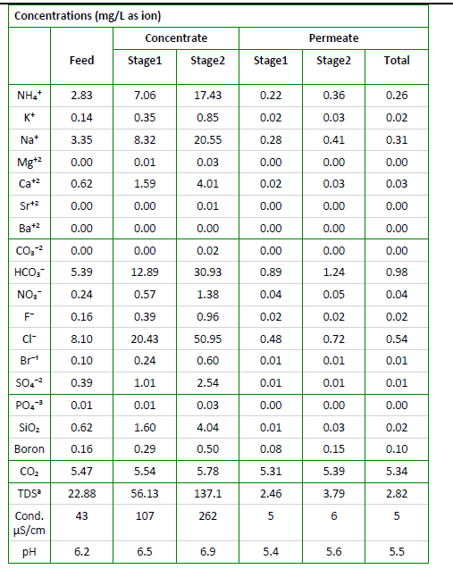
Option 7- HFW Effluent treatment (UF& RO)
Pass 1 – BWRO
Pass 2 - BWRO

